Slide 1
CART: Leveraging geospatial data and decision support for more efficient NRCS conservation planning
Michael Robotham
National Soil Scientist, USDA-NRCS
ASA-CSSA-SSSA Annual Meeting
San Antonio, TX
November 11, 2019

Slide 2
NRCS FY2020 priorities
Implement and deliver the 2018 Farm Bill to our nation’s farmers, ranchers, and private foresters.
Streamline our processes and program delivery to best serve our customers.
Better understand customer needs and improve overall customer service.
Soil Health
Chief Matt Lohr
Notes:
Check 2020 priorities

Slide 3
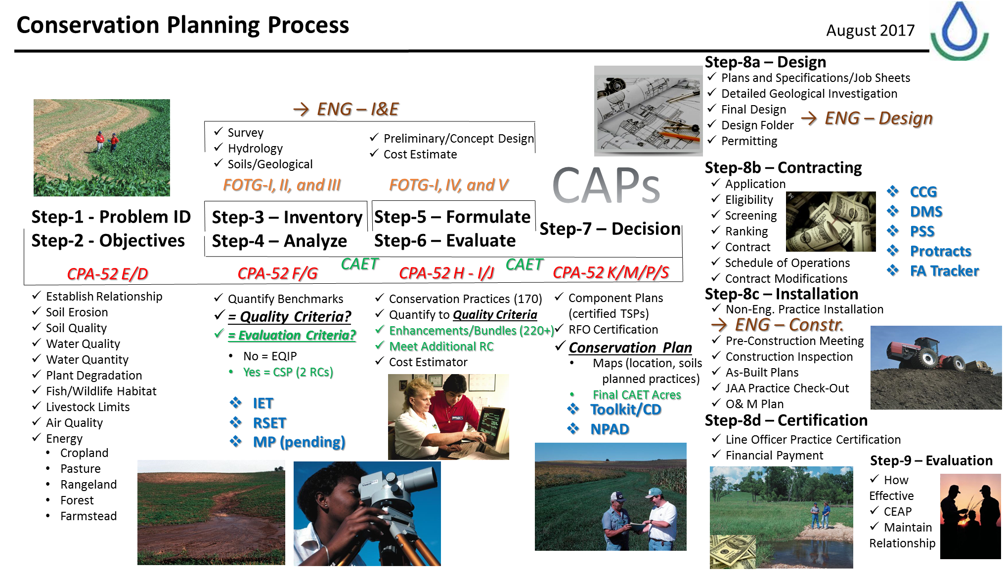
Conservation Planning - What NRCS is about

Slide 4
Mandate (Conservation Expansion)
NRCS Challenges:
Continued growth in consecutive Farm Bills has demanded more focus on Program Delivery
FY18 Total Appropriations - $4.3 Billion
FY18 – Farm Bill Mandatory Spending – 83%
Applications 138,000 EQIP 14,570 CSP
Contracts 38,726 EQIP 7,713 CSP
Funding $1.63 B $1.35 B
How can we stay true to our mission and meet this new reality?

Slide 5
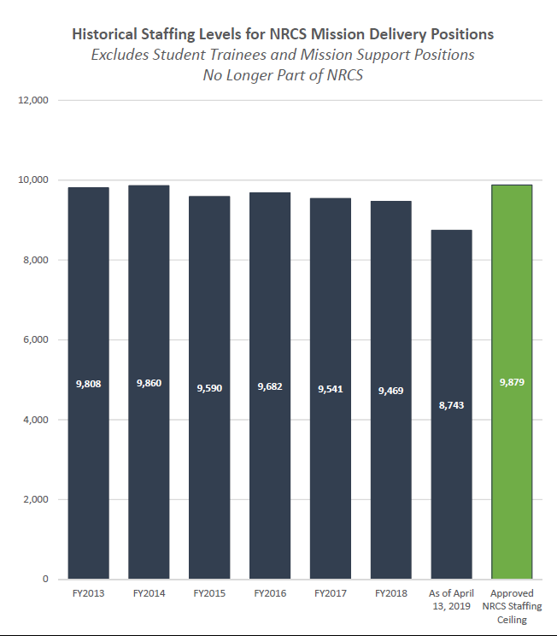
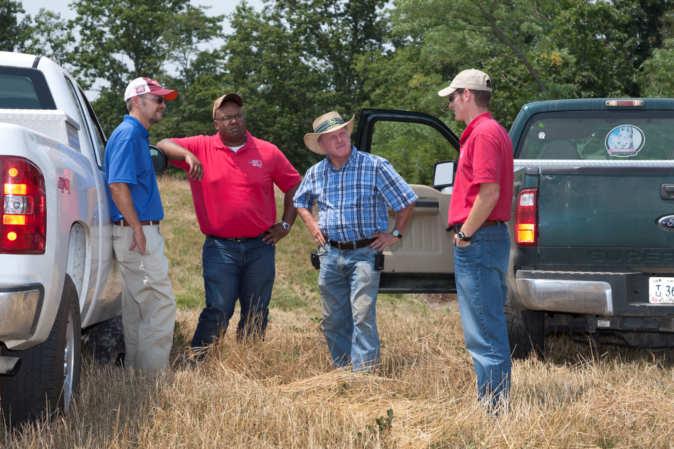
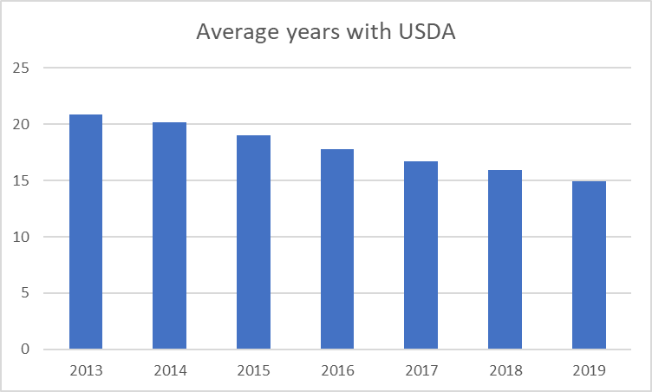
Level staffing numbers
With much less experience

Slide 6
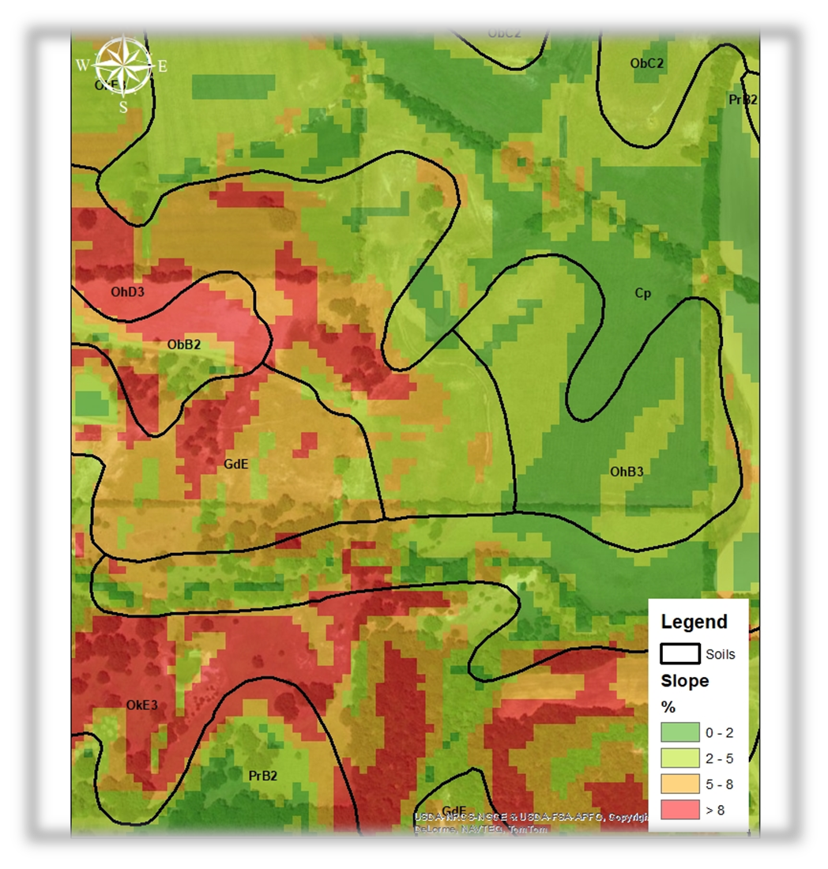
Big data and derivatives
Water Features
Soils
Special Resource Concerns
Wildlife habitat suitability
Vulnerability – Leaching
Vulnerability – Runoff
Vulnerability - Erosion
Vulnerability – Soil Compaction
Land Use / Land Cover
LiDAR

Slide 7

Decision Support Systems
DFN: A decision support system (DSS) is a computerized program used to support determinations, judgments, and courses of action … (https://www.investopedia.com/terms/d/decision-support-system.asp)
Why use a DSS?
Easily access data and information (knowledge) about new situations and circumstances
Determine most appropriate / likely to succeed course of action
Rank and prioritize activities
Benefits
Efficiency – make a decision more quickly
Consistency – make similar decisions in similar situation
Documentation – what was the recommended action and why
Notes:
Also called decision aides, expert systems, knowledge systems decision support tools, etc.
Myriad of definitions – key concepts: Computer based, support, determination/judgement/course of action – goal is to help make a better decision

Slide 8

Conservation
Assessment
Ranking
Tool
Set of business practices to streamline Conservation Planning and Program Delivery
Program Neutral Decision Support System software application
Any USDA Conservation Program!
Notes:
Priorities in the Farm Bill and Secretary
Streamline programs, increase efficiency and increase customer service – Sonny’s charge ahead of Farm Bill
Mention my presentation on the philosophy behind CART at 3:45 pm in Room 304B

Slide 9
Spatial data & derivatives
(aka “Big Data)
Spatial data & derivatives
(aka “Big Data)
CART Components
CA Conservation Assessment
CA Conservation Assessment
RT
Ranking Tool
RT
Ranking Tool
Site-specific data
Site-specific data

Slide 10
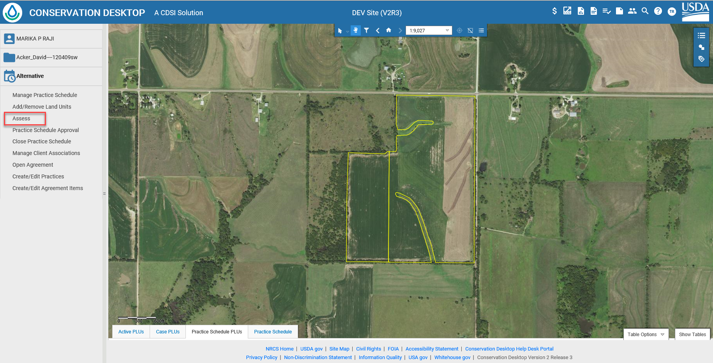
CART Process
Identify location
Determine goals/objectives
Identify priority resource concerns to address
Identify and select alternatives
Estimate effects of proposed management changes
Vulnerability assessments
Make decisions
Implement practices
Evaluate – did management address the concern?
CA
RT
Financial support?

Slide 11
Vulnerability assessment / management options
Existing Condition
Existing Practice
Planned Practices
Assessment Ranking Pts
Flat 0 Vulnerability +40 Planned Practices
Gently Rolling 20 Vulnerability +40 Planned Practices
Steep Hillside 50 Vulnerability +40 Planned Practices
20 points
Ex. Medium Residue Crop
10 points
Ex. Filter Strip
Planned Practices
40 Points
Ex. Cover Crop and Minimal Tillage
0 Vulnerability
Ranking Points
15 Point Threshold
(Flat)
20 Vulnerability Ranking Points
50 Point Threshold
(Gently Rolling)
50 Point Threshold
50 Vulnerability Ranking Points
80 Point Threshold
(Steep Hillside)
80 Point Threshold

Slide 12
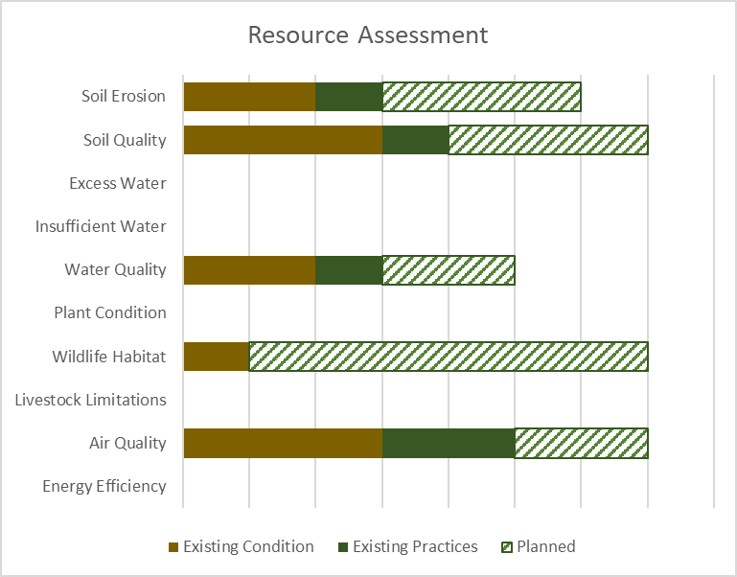
Communicate with clients
Threshold
Intuitive display of results
+
+
+
+
+
+
+
+
+
+
Planned practices
Existing Condition & Practices

Slide 13
Status update / What is next?
Began deployment – FY2020
Deploying new functionality ~ every 10 weeks
First priorities (target: January 2020)
Resource assessments
Application ranking
Additional capabilities (throughout FY2020)
Soil and related interpretations (vulnerability estimates)
Outcomes development
Environmental evaluations
Notes:
Jimmy: We began deploying CART at the beginning of this fiscal year. We are working on deploying new functionality roughly every 10-weeks. The first priorities are related to conservation planning (resource assessments) and ranking of applications (should be ready in early January), and increasing functionality to incorporate more capability to related to soil interpretations, outcomes development, environmental evaluations, etc. throughout the year. In FY-2021, we hope to have enough functionality we can more seamlessly exchange information with our partners who help us do conservation planning activities across the landscape :)

Slide 14
CART V2.0 and beyond – continuous improvement
Improve foundational spatial data and information
Expand, update, and refine current resource concern risk assessment algorithms
Develop resource concern risk assessment algorithms for additional concerns
Better codify the relative effects of conservation practices on resource concerns
Document and account for appropriate variation (spatial, temporal)
Develop and implement protocols to exchange information with our partners doing conservation planning
Notes:
TSP certification – working with professional societies

Slide 15

Questions
USDA is an equal opportunity provider, employer, and lender

